Slide 1
STEPHEN OLUWOLE AWOKOYA
Foundation for Science Education (SOAFSE)
27th Annual Lecture, Award of Honours & Postgraduate Scholarships
LECTURE TOPIC
Legacy of Learning: From Universal Primary Education to Today’s Digital Literacy and AI
Guest Lecturer
Chairman
Guest of Honour
Prof. Eyitope O. Ogunmodede
Chief Wole Olanipekun
Dr. Olutoyin Okeowo
CFR, SAN
Former Vice Chancellor Obafemi Awolowo Univeristy
President, Association of Artificial Intelligence Practioners (NAAIP)
Pro Chancellor, University of Lagos
Pro Chancellor, Ajayi Crowther University
HONOUREES
FAEng.
Engr. Prof. Ogbemi Omatete
Ms. Funke Opeke
Engr. Austin O. Avuru
FNAPE
Rtd. Prof of Chem Eng, Covenant University
Founder, MainOne
Chairman, AA Holdings Ltd
Tuesday, 18th March 2025

Slide 2
STEPHEN OLUWOLE AWOKOYA
Foundation for Science Education (SOAFSE)
27th Annual Lecture, Award of Honours & Postgraduate Scholarships
INTRODUCTION OF CHAIRMAN, SPECIAL GUEST OF HONOUR, HONOUREES AND SPECIAL GUESTS

Slide 3
STEPHEN OLUWOLE AWOKOYA
Foundation for Science Education (SOAFSE)
27th Annual Lecture, Award of Honours & Postgraduate Scholarships
WELCOME ADDRESS
BY
PROF. AYODELE OGUNYE
CHAIRMAN BOARD OF TRUSTEES

Slide 4
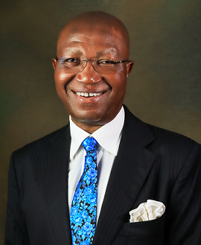
STEPHEN OLUWOLE AWOKOYA
Foundation for Science Education (SOAFSE)
27th Annual Lecture, Award of Honours & Postgraduate Scholarships
CHAIRMAN’S OPENING ADDRESS
Chief Wole Olanipekun CFR, SAN Pro Chancellor University of Lagos

Slide 5
STEPHEN OLUWOLE AWOKOYA
Foundation for Science Education (SOAFSE)
27th Annual Lecture, Award of Honours & Postgraduate Scholarships
AWARD OF SCHOLARSHIPS
BY
DR. FOLA AWOKOYA Ph.D.(Engr.)
MEMBER , BOARD OF TRUSTEES
&
MRS. YETSA OSARA
MEMBER , BOARD OF TRUSTEES

Slide 6
STEPHEN OLUWOLE AWOKOYA
Foundation for Science Education (SOAFSE)
27th Annual Lecture, Award of Honours & Postgraduate Scholarships
TOTAL SCHOLARSHIPS AWARDED TO DATE: 134

Slide 7
COURSE PROGRAM OF AWARDS
M.Sc. & Ph.D courses in science, Technology engineering and mathematics COURSES (STEM)

Slide 8
TOP 5 UNIVERSITIES WITH AWARDS TO DATE
UNIVERSITY | NUMBER OF AWARDS TO DATE
UNIVERSITY OF LAGOS | 31
UNIVERSITY OF NIGERIA, NSUKKA | 15
UNIVERSITY OF IBADAN | 13
NNMADI AZIKWE UNIVERSITY | 10
COVENANT UNIVERSITY | 8
TOTAL AWARDS TO DATE: 134
TOTAL NUMBER OF UNIVERSITIES: 30

Slide 9
PROCESS OF SCHOLARSHIP AWARD
STEP 1: NOMINATION OF CANDIDATES BY THE DEANS OF THE VARIOUS FACULTIES OR HEADS OF DEPARTMENTS
STEP 2: AWARDEES ARE CHOSEN BASED ON EXCELLENCE IN EDUCATIONAL PERFORMANCE
STEP 3: INTERVIEW OF THE SHORTLISTED CANDIDATES BY THE BOARD OF TRUSTEES.

Slide 10
2024 APPLICATIONS /NOMINATIONS
No of UNI-54, No of Nominations-153
TOP 10 UNIVERSITY NOMINATION
S/N | University | Nominations
1 | Landmark University | 15
2 | Lagos State University | 11
3 | University of Ilorin | 11
4 | Ibrahim Badamasi Babangida University | 9
5 | Federal University of Agriculture, Abeokuta | 7
6 | Nnamdi Azikwe University | 7
7 | Ekiti State University | 4
8 | Modibbo Adama University | 4
9 | University of Ibadan | 4
10 | University of Lagos | 4

Slide 11
DISTRIBUTUTION OF CLASS OF DEGREES OF APPLICANTS
First Class/Distinction Degree Graduates
111
2nd Class Graduates
32
No Transcript
10
Total
153

Slide 12
POST-GRADUATE SCHOLARSHIP AWARD
COVERS TUITION & BOARD
=N=500,000 PER YEAR
RENEWABLE EVERY YEAR FOR A MAXIMUM OF 3 YEARS
TENABLE IN ANY NIGERIAN UNIVERSITY
FOR FOREIGN UNIVERSITY ADMISSION. 1st YEAR SCHOLARSHIP CONVERTED TO TRAVEL GRANT

Slide 13
STEPHEN OLUWOLE AWOKOYA
Foundation for Science Education (SOAFSE)
27th Annual Lecture, Award of Honours & Postgraduate Scholarships
2025 POSTGRADUATE SCHOLARSHIP AWARDEES

Slide 14
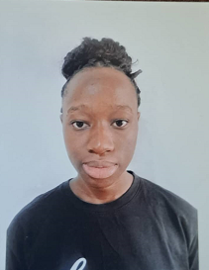
YEAR 2025 POST-GRADUATE SCHOLARSHIP AWARDEES
9 Distinctions out of 9 Subjects in SSC Exams with 4 A1
B.Sc. 1st Class Honours Anatomy
Babcock University
CGPA 4.71
Miss. Ifeoluwapo Oseni
AWARD FOR: M.Sc. Anatomy

Slide 15
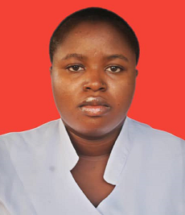
YEAR 2025 POST-GRADUATE SCHOLARSHIP AWARDEES
9 Distinctions out of 9 Subjects in SSC Exams with 5 A1s
B.Sc. 1st Class Honours Nursing Science
University of Ilorin
CGPA 4.81
Miss. Elizabeth Akanni
AWARD FOR: M.Sc. Nursing Science

Slide 16
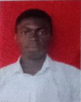
YEAR 2025 POST-GRADUATE SCHOLARSHIP AWARDEES
9 Distinctions in 9 subjects in SSCE with 3 A1s
B.Sc. 1st Class/ Distinction Honours Pharmacy
Delta State University
4.91 CGPA
Mr. Israel Obodeh
AWARD FOR: Masters Degree in Pharmacy

Slide 17
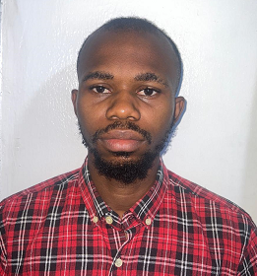
YEAR 2025 POST-GRADUATE SCHOLARSHIP AWARDEES
8 Distinctions in 9 subjects in SSCE with 4 A1s
B.Sc. 1st Class Honours Electrical & Electronics Engineering
Federal University of Agriculture, Abeokuta
4.82 CGPA
Mr. Oreoluwa Onanuga
AWARD FOR: Masters Degree in
Electrical & Electronics Engineering

Slide 18
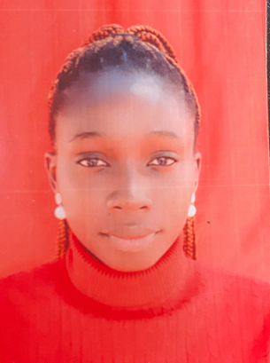
YEAR 2025 POST-GRADUATE SCHOLARSHIP AWARDEES
8 Distinctions out of 9 subjects in SSCE with 4 A1s
B.Sc. 1st Class Honours Pharmaceutical Science
University of Nigeria, Nssukka
4.98 CGPA
Best Graduating Student in the Faculty & University 2023
Miss Amarachi Eze
AWARD FOR: M.Sc. Pharmaceutical Science

Slide 19
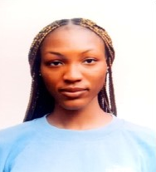
YEAR 2025 POST-GRADUATE SCHOLARSHIP AWARDEES
8 Distinctions in 9 subjects SSCE
B.Sc. 1st Class Honours Biochemistry
Landmark University, Kwara State
4.98 CGPA
Best Graduating Student in Biochemistry & University 2024
Miss Priscilla Ojo
AWARD FOR: Postgraduate Study in Biochemistry

Slide 20
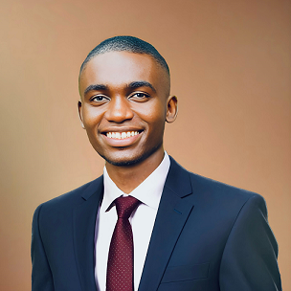
YEAR 2025 POST-GRADUATE SCHOLARSHIP AWARDEES
9 Distinctions in 9 subjects SSCE including 7 A1s
B.Sc. 1st Class Honours Electrobics/Computer Engineering
Nnamdi Azikwe University, Awka
4.95 CGPA
Best Graduating Student in Department
Mr. Tochukwu Egwuchika
AWARD FOR: Masters Program in Electronics/Computer Engineering

Slide 21
STEPHEN OLUWOLE AWOKOYA
Foundation for Science Education (SOAFSE)
27th Annual Lecture, Award of Honours & Postgraduate Scholarships
2025 AWARDEES
Mr. Tochukwu Egwuchika
Miss Priscilla
Ojo
Miss Ifeoluwapo
Oseni
Miss Amarachi
Eze
Mr. Oreoluwa
Onanuga
Mr. Israel
Obodeh
Miss Elizabeth Akanni

Slide 22
STEPHEN OLUWOLE AWOKOYA
Foundation for Science Education (SOAFSE)
27th Annual Lecture, Award of Honours & Postgraduate Scholarships
Legacy of Learning: From Universal Primary Education to Today’s Digital Literacy and AI
Guest Lecturer
Chairman
Guest of Honour
Prof. Eyitope O. Ogunbodede
Chief Wole Olanipekun
Dr. Olutoyin Okeowo
CFR, SAN
Former Vice Chancellor Obafemi Awolowo Univeristy
President, Association of Artificial Intelligence Practioners (NAAIP)
Pro Chancellor, University of Lagos
Pro Chancellor, Ajayi Crowther University

Slide 23
STEPHEN OLUWOLE AWOKOYA
Foundation for Science Education (SOAFSE)
27th Annual Lecture, Award of Honours & Postgraduate Scholarships
AWARD OF HONOURS

Slide 24
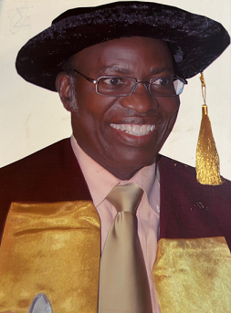
YEAR 2025 PARTNER IN SCIENCE EDUCATION
HONOURS AWARDEE
Engr. Prof. Ogbemi Omatete FAEng.
Rtd. Prof. of Chem. Eng. Covenant University

Slide 25
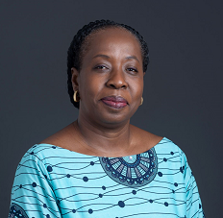
YEAR 2025 PARTNER IN SCIENCE EDUCATION
HONOURS AWARDEE
Ms. Funke Opeke Founder, MainOne

Slide 26
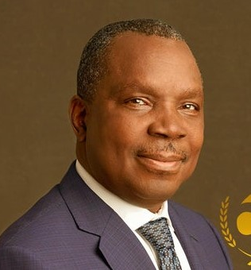
YEAR 2025 PARTNER IN SCIENCE EDUCATION
HONOURS AWARDEE
Engr. Austin Avuru FNAPE
Chairman AA Holdings Ltd.

Slide 27
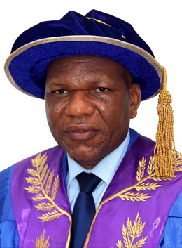
STEPHEN OLUWOLE AWOKOYA
Foundation for Science Education (SOAFSE)
27th Annual Lecture, Award of Honours & Postgraduate Scholarships
INTRODUCTION OF GUEST SPEAKER
Prof. Eyitope Ogunbodede
Former Vice-Chancellor – Obafemi Awolowo University
President, Association of Artificial Inteligence Practitioners (NAAIP)

Slide 28
STEPHEN OLUWOLE AWOKOYA
Foundation for Science Education (SOAFSE)
27th Annual Lecture, Award of Honours & Postgraduate Scholarships
Legacy of Learning: From Universal Primary Education to Today’s Digital Literacy and AI
Guest Lecturer
Chairman
Guest of Honour
Prof. Eyitope O. Ogunbodede
Chief Wole Olanipekun
Dr. Olutoyin Okeowo
CFR, SAN
Former Vice Chancellor Obafemi Awolowo University
President, Association of Artificial Intelligence Practitioners (NAAIP)
Pro Chancellor, University of Lagos
Pro Chancellor, Ajayi Crowther University

Slide 29
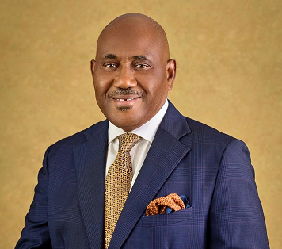
STEPHEN OLUWOLE AWOKOYA
Foundation for Science Education (SOAFSE)
27th Annual Lecture, Award of Honours & Postgraduate Scholarships
GUEST OF HONOUR’S REMARKS
Dr. Olutoyin Okeowo
Pro Chancellor, Ajayi Crowther University

Slide 30
STEPHEN OLUWOLE AWOKOYA
Foundation for Science Education (SOAFSE)
27th Annual Lecture, Award of Honours & Postgraduate Scholarships
VOTE OF THANKS
BY
Dr. Sonny F. Kuku
Vice-Chairman, Board of Trustees

Slide 31
STEPHEN OLUWOLE AWOKOYA
Foundation for Science Education (SOAFSE)
27th Annual Lecture, Award of Honours & Postgraduate Scholarships
Legacy of Learning: From Universal Primary Education to Today’s Digital Literacy and AI
Guest Lecturer
Chairman
Guest of Honour
Prof. Eyitope O. Ogunbodede
Chief Wole Olanipekun
Dr. Olutoyin Okeowo
CFR, SAN
Former Vice Chancellor Obafemi Awolowo Univeristy
President, Association of Artificial Intelligence Practitioners (NAAIP)
Pro Chancellor, University of Lagos
Pro Chancellor, Ajayi Crowther University

