Slide 1
STEPHEN OLUWOLE AWOKOYA
FOUNDATION FOR SCIENCE EDUCATION
th
Annual Lecture, Award of Honours
& Post Graduate Scholarships
26
A LOOK INTO THE FUTURE: PROVIDING FIT FOR PURPOSE EDUCATION FOR NATIONAL DEVELOPMENT
Special Guest of Honour
Chairman
Baba Oba Dr. Oladele Fajemirokun
Chairman AIICO Plc.
Prof. Konyin Ajayi SAN
Partner , Olaniwun Ajayi LP
Prof. Folasade Ogunsola, OON, FAS
Vice-Chancellor- University of Lagos
Guest Speaker

Slide 2
STEPHEN OLUWOLE AWOKOYA
FOUNDATION FOR SCIENCE EDUCATION
th
Annual Lecture, Award of Honours
& Post Graduate Scholarships
26
INTRODUCTION OF CHAIRMAN, SPECIAL GUEST OF HONOUR, HONOUREES AND SPECIAL GUESTS

Slide 3
STEPHEN OLUWOLE AWOKOYA
FOUNDATION FOR SCIENCE EDUCATION
th
Annual Lecture, Awath of Honours
&Post Graduate Scholarships
26
WELCOME ADDRESS
BY
PROF. AYODELE OGUNYE
CHAIRMAN BOARD OF TRUSTEES

Slide 4
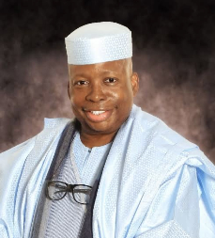
STEPHEN OLUWOLE AWOKOYA
FOUNDATION FOR SCIENCE EDUCATION
Annual Lecture, Award of Honours
&Post Graduate Scholarships
th
26
CHAIRMAN’S OPENING ADDRESS
Baba Oba Dr. Oladele Fajemirokun
Chairman AIICO

Slide 5
STEPHEN OLUWOLE AWOKOYA
FOUNDATION FOR SCIENCE EDUCATION
Annual Lecture ,Award of Honours
& Post Graduate Scholarships
th
26
AWARD OF SCHOLARSHIPS
BY
DR. FOLA AWOKOYA Ph.D.(Engr.)
MEMBER , BOARD OF TRUSTEES

Slide 6
STEPHEN OLUWOLE AWOKOYA
FOUNDATION FOR SCIENCE EDUCATION
Annual Lecture ,Award of Honours
& Post Graduate Scholarships
th
26
TOTAL SCHOLARSHIP AWARDED TO DATE: 128

Slide 7
STEPHEN OLUWOLE AWOKOYA
FOUNDATION FOR SCIENCE EDUCATION
COURSE PROGRAM OF AWARD
M.Sc. COURSES
ARCHITECTURE
AGRICULTURE AND INDUSTRIAL TECHNOLOGY
BIOCHEMISTRY
BIOLOGICAL SCIENCES
BIOLOGICAL SCIENCES
CELL BIOLOGY & GENETICS
CHEMICAL ENGINEERING
CHEMISTRY
CIVIL ENGINEERING
COMPUTER ENGINEERING
COMPUTER SCIENCE
CONSTUCTION ENGINEERING TECHNOLOGY
CROP/SOIL SCIENCE
ELECTRONICS & ELECTRICAL ENGINEERING
HUMAN NUTRITION
INFORMATION TECHNOLOGY
MATHEMATICS
MECHANICAL ENGINEERING
MECHATRONICS ENGINEERING
MICROBIOLOGY
PETROLEUM ENGINEERING
PHARMACOLOGY
PHYSICS
PHYSIOLOGY
PRODUCTION ENGINEERING
PUBLIC HEALTH
SCIENCE EDUCATION
Ph.D. COURSES
CARDIOVASCULAR MEDICINE
CHEMICAL PATHOLOGY
CLINICAL PHARMACY
DENTAL SURGERY
MATHS EDUCATION
MECHANICAL ENGINEERING
MEDICINE
PAEDIATRIC MEDICINE
PHARMACEUTICS
PREVENTIVE DENTISTRY
SCIENCE EDUCATION

Slide 8
STEPHEN OLUWOLE AWOKOYA
FOUNDATION FOR SCIENCE EDUCATION
TOP 5 UNIVERSITIES WITH AWARDS TO DATE
UNIVERSITY | NO OF AWARDS TO DATE
UNIVERSITY OF LAGOS | 31
UNIVERSITY OF NIGERIA, NSUKKA | 14
UNIVERSITY OF IBADAN | 13
NNMADI AZIKWE UNIVERSITY | 9
COVENANT UNIVERSITY | 8
TOTAL AWARDS TO DATE 128
TOTAL NO OF UNIVERSITIES 30

Slide 9
S. O. AWOKOYA FOUNDATION FOR SCIENCE EDUCATION
PROCESS OF SCHOLARSHIP AWARD
1. NOMINATION OF CANDIDATES BY THE DEANS OF THE VARIOUS
FACULTIES OR HEADS OF DEPARTMENTS
2. AWARDEES ARE CHOSEN BASED ON EXCELLENCE IN
EDUCATIONAL PERFORMANCE
3. INTERVIEW OF THE SHORTLISTED CANDIDATES BY THE BOARD OF
TRUSTEES.

Slide 10
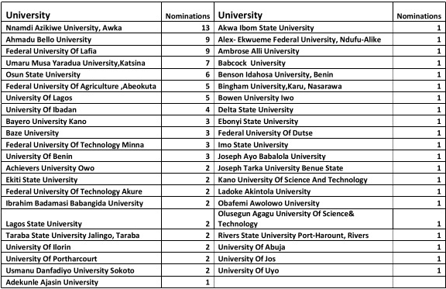
S. O. AWOKOYA FOUNDATION FOR SCIENCE EDUCATION
2024 APPLICATIONS /NOMINATIONS
No of UNI-43, No of Nominations-110

Slide 11
S. O. AWOKOYA FOUNDATION FOR SCIENCE EDUCATION
DISTRIBUTUTION OF CLASS OF DEGREES OF APPLICANTS
FIRST CLASS/DISTINCTION DEGREE GRADUATES 71
2ND CLASS GRADUATES 34
TOTAL 110

Slide 12
S. O. AWOKOYA FOUNDATION FOR SCIENCE EDUCATION
POST-GRADUATE SCHOLARSHIP AWARD
1. COVERS TUITION & BOARD
2. =N=500,000 PER YEAR
3. RENEWABLE EVERY YEAR FOR A MAXIMUM OF 3 YEARS
TENABLE IN ANY NIGERIAN UNIVERSITY
FOR FOREIGN UNIVERSITY ADMISSION. 1st YEAR
SCHOLARSHIP CONVERTED TO TRAVEL GRANT

Slide 13
STEPHEN OLUWOLE AWOKOYA
FOUNDATION FOR SCIENCE EDUCATION
th
Annual Lecture, Award of Honours &
Post Graduate Scholarships
26
2024 POSTGRADUATE SCHOLARSHIP AWARDEES

Slide 14
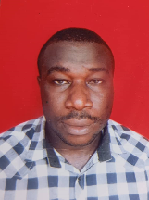
S. O. AWOKOYA FOUNDATION FOR SCIENCE EDUCATION
YEAR 2024 POST-GRADUATE SCHOLARSHIP AWARDEES
8 Distinctions out of 9 Subjects in SSC Exams with 4 A1
B.Sc. 1st Class Honours Electrical Engineering
(Nnamdi Azikwe University )
CGPA 4.66
Mr. Mirace Ebube Chukwuma
AWARD FOR: M.Sc. Electrical Engineering

Slide 15
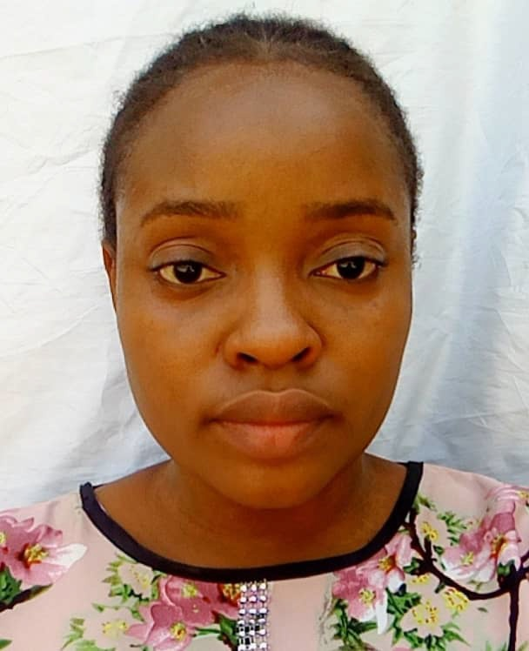
S. O. AWOKOYA FOUNDATION FOR SCIENCE EDUCATION
YEAR 2024 POST-GRADUATE SCHOLARSHIP AWARDEES
9 Distinctions out of 9 subjects in SSCE
with 6 A1s
B.Sc. First Class Honours Mechanical Engineering
( Akwa Ibom State University)
4.53 CGPA
Miss Faith Umo
AWARD FOR: Masters Degree in Mechanic /Mechatronics Engineering

Slide 16
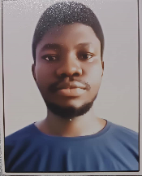
S. O. AWOKOYA FOUNDATION FOR SCIENCE EDUCATION
YEAR 2024 POST-GRADUATE SCHOLARSHIP AWARDEES
9 Distinctions out of 9 subjects in SSCE
with 4 A1s
B.Sc. First Class Honours Cell Biology& Genetics
( University of Lagos)
4.93 CGPA
Mr. Oluwatobiloba Osedimilehin
AWARD FOR: Masters Degree in Cell Biology and Genetics

Slide 17
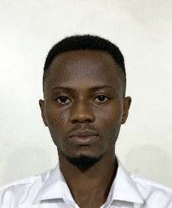
S. O. AWOKOYA FOUNDATION FOR SCIENCE EDUCATION
YEAR 2024 POST-GRADUATE SCHOLARSHIP AWARDEES
8 Distinctions out of 9 subjects in SSCE (with 4 A1)
B.Sc. Petroleum Engineering
(First Class Honours
4.93 CGPA
( University of Ibadan )
Mr. Gbenga Awojinrin
AWARD FOR: M.Sc. Petroleum Engineering

Slide 18
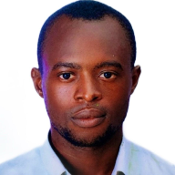
S. O. AWOKOYA FOUNDATION FOR SCIENCE EDUCATION
YEAR 2024 POST-GRADUATE SCHOLARSHIP AWARDEES
9 Distinctions in 9 subjects SSCE (including 8 A1)
B.Sc. Electrical/Electronics engineering
(First Class Honours)
4.73 CGPA
( Federal University of Technology, Minna)
Mr. Saidu Abubakar Saidu
AWARD FOR: Postgraduate study in Electrical/Electronics Engineering

Slide 19
S. O. AWOKOYA FOUNDATION FOR SCIENCE EDUCATION
26th Annual Lecture &
Award of Post-Graduate Scholarships
2024 AWARDEES
Mr. Saidu Saidu Mr. Gbenga Awojinrin
Mr. Oluwatobilola Johnson Miss Faith Umo Mr. Miracle Chukwuma,

Slide 20
STEPHEN OLUWOLE AWOKOYA
FOUNDATION FOR SCIENCE EDUCATION
th
Annual Lecture, Award of Honours
& Post Graduate Scholarships
26
A LOOK INTO THE FUTURE: PROVIDING FIT FOR PURPOSE EDUCATION FOR NATIONAL DEVELOPMENT
Special Guest of Honour
Chairman
Baba Oba Dr. Oladele Fajemirokun
Chairman AIICO Plc.
Prof. Konyin Ajayi SAN
Partner , Olaniwun Ajayi LP
Prof. Folasade Ogunsola, OON, FAS
Vice-Chancellor- University of Lagos
Guest Speaker

Slide 21
STEPHEN OLUWOLE AWOKOYA
FOUNDATION FOR SCIENCE EDUCATION
Annual Lecture , Award of Honours&
Post Graduate Scholarships
th
26
AWARD OF HONOURS

Slide 22
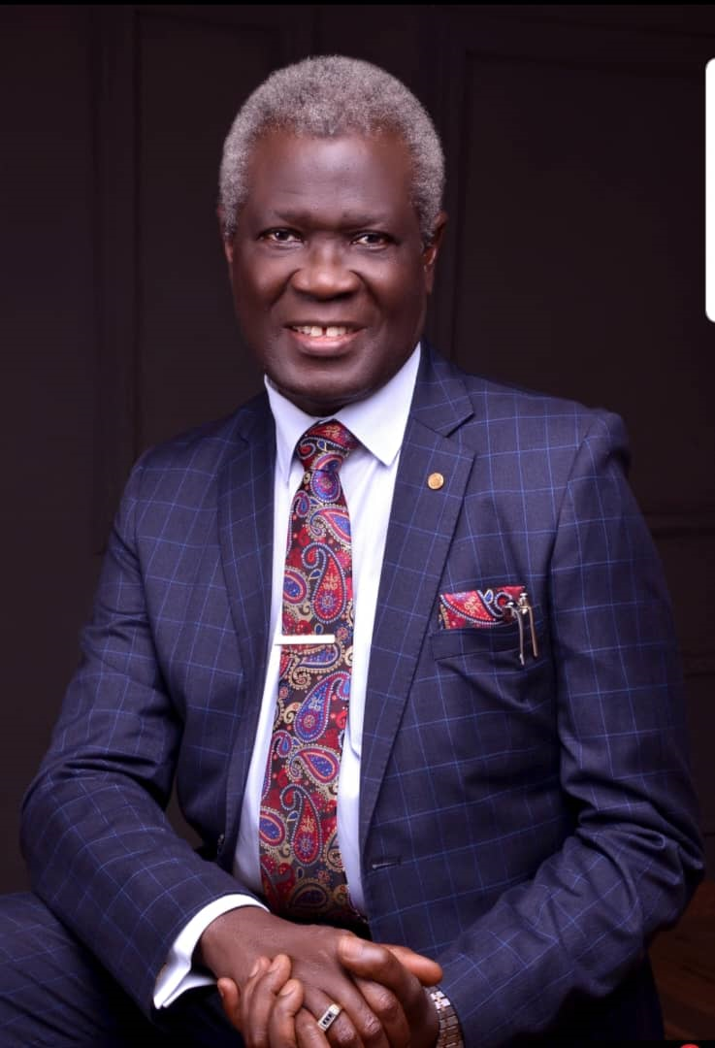
S. O. AWOKOYA FOUNDATION FOR SCIENCE EDUCATION
YEAR 2024 PARTNER IN SCIENCE EDUCATION
HONOURS AWARDEE
Prof. Oladapo Ashiru OFR, FAMedS
Chairman/CBD
Matt Group of Health Services

Slide 23
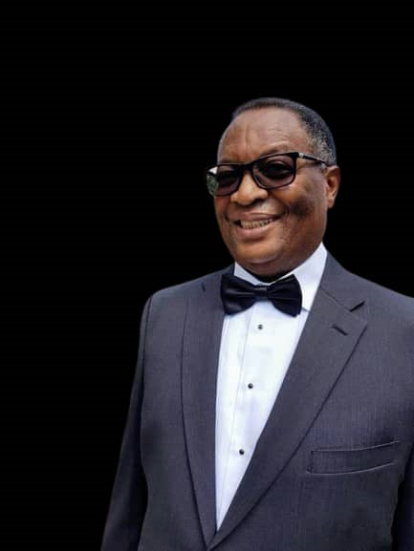
S. O. AWOKOYA FOUNDATION FOR SCIENCE EDUCATION
YEAR 2024 PARTNER IN SCIENCE EDUCATION
HONOURS AWARDEE
Rear Admiral A. Afolabi Macaulay, (rtd)
Chairman Oakwood Heights Ltd

Slide 24
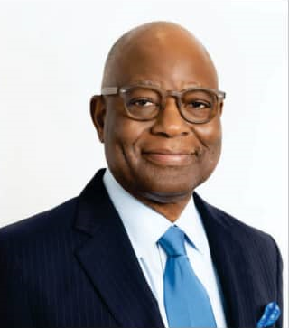
S. O. AWOKOYA FOUNDATION FOR SCIENCE EDUCATION
YEAR 2024 PARTNER IN SCIENCE EDUCATION
HONOURS AWARDEE
Mr. H. Sola Oyinlola
Chairman GTCO Holdings Plc.

Slide 25
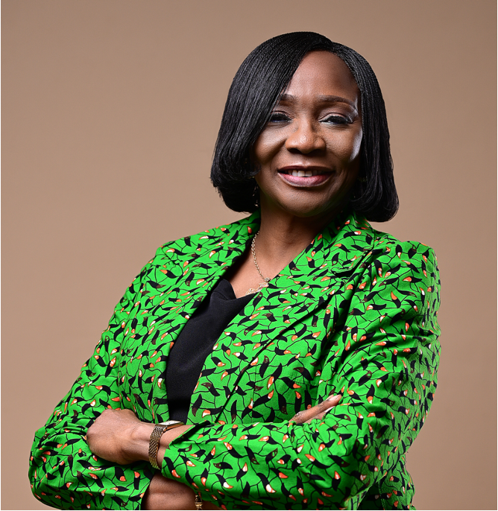
STEPHEN OLUWOLE AWOKOYA
FOUNDATION FOR SCIENCE EDUCATION
th
Annual Lecture , Award of Honours
& Post Graduate Scholarships
26
INTRODUCTION OF GUEST SPEAKER
Prof. Folasade Ogunsola, OON, FAS
.
Vice-Chancellor - University of Lagos

Slide 26
STEPHEN OLUWOLE AWOKOYA
FOUNDATION FOR SCIENCE EDUCATION
th
Annual Lecture, Award of Honours
& Post Graduate Scholarships
26
A LOOK INTO THE FUTURE: PROVIDING FIT FOR PURPOSE EDUCATION FOR NATIONAL DEVELOPMENT
Special Guest of Honour
Chairman
Baba Oba Dr. Oladele Fajemirokun
Chairman AIICO Plc.
Prof. Konyin Ajayi SAN
Partner , Olaniwun Ajayi LP
Prof. Folasade Ogunsola, OON, FAS
Vice-Chancellor- University of Lagos
Guest Speaker

Slide 27
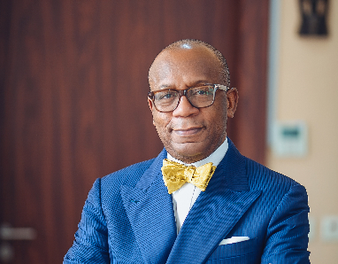
STEPHEN OLUWOLE AWOKOYA
FOUNDATION FOR SCIENCE EDUCATION
th
Annual Lecture, Award of Honours
& Post Graduate Scholarships
26
GUEST OF HONOUR’S REMARKS
Prof. Konyin Ajayi, SAN
Partner, Olaniwun Ajayi LP

Slide 28
STEPHEN OLUWOLE AWOKOYA
FOUNDATION FOR SCIENCE EDUCATION
th
Annual Lecture, Award of Honours &
Post Graduate Scholarships
26
VOTE OF THANKS
BY
Otunba Otukayode Otufale
Member , Board of Trustees

Slide 29
STEPHEN OLUWOLE AWOKOYA
FOUNDATION FOR SCIENCE EDUCATION
th
Annual Lecture, Award of Honours
& Post Graduate Scholarships
26
A LOOK INTO THE FUTURE: PROVIDING FIT FOR PURPOSE EDUCATION FOR NATIONAL DEVELOPMENT
Special Guest of Honour
Chairman
Baba Oba Dr. Oladele Fajemirokun
Chairman AIICO Plc.
Prof. Konyin Ajayi SAN
Partner , Olaniwun Ajayi LP
Prof. Folasade Ogunsola, OON, FAS
Vice-Chancellor- University of Lagos
Guest Speaker

