Slide 1
STEPHEN OLUWOLE AWOKOYA
FOUNDATION FOR SCIENCE EDUCATION
th
Annual Lecture, Award of Honours
& Post Graduate Scholarships
25
EPIDEMIOLOGY AND TECHNOLOGY, A LOOK AT THE PAST AND PRESENT: JUSTIFICATION FOR MODIFIERS IN MAJOR NON-COMMUNICABLE DISEASES
Special Guest of Honour
Chairman
Chief Chamberlain Oyibo FNMGS, FNAPE
Former GMD NNPC
CEO, Prime Energy Resources
H. E Prince Dapo Abiodun MFR
Executive Governor Ogun State
Prof. Grace O. Otinwa, B.Ed., M.Ed., Ph.D., FNASSAM, FNIS
Professor of Excercise Physiology
University of Lagos
Guest Speaker

Slide 2
STEPHEN OLUWOLE AWOKOYA
FOUNDATION FOR SCIENCE EDUCATION
th
Annual Lecture, Award of Honours
& Post Graduate Scholarships
25
INTRODUCTION OF CHAIRMAN, SPECIAL GUEST OF HONOUR, HONOUREES AND SPECIAL GUESTS

Slide 3
STEPHEN OLUWOLE AWOKOYA
FOUNDATION FOR SCIENCE EDUCATION
th
Annual Lecture, Awath of Honours
&Post Graduate Scholarships
25
WELCOME ADDRESS
BY
SENATOR OLABIYI DUROJAIYE
CHAIRMAN BOARD OF TRUSTEES

Slide 4
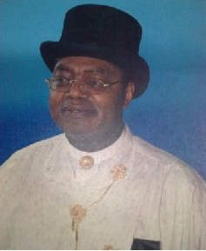
STEPHEN OLUWOLE AWOKOYA
FOUNDATION FOR SCIENCE EDUCATION
Annual Lecture, Award of Honours
&Post Graduate Scholarships
th
25
CHAIRMAN’S OPENING ADDRESS
Chief Chamberlain Oyibo
Former GMD NNPC
CEO Prime Energy Resources

Slide 5
STEPHEN OLUWOLE AWOKOYA
FOUNDATION FOR SCIENCE EDUCATION
Annual Lecture ,Award of Honours
& Post Graduate Scholarships
th
25
AWARD OF SCHOLARSHIPS
BY
DR. FOLA AWOKOYA Ph.D.(Engr.)
MEMBER , BOARD OF TRUSTEES

Slide 6
STEPHEN OLUWOLE AWOKOYA
FOUNDATION FOR SCIENCE EDUCATION
Annual Lecture ,Award of Honours
& Post Graduate Scholarships
th
25
SCHOOL RENOVATION PROJECTS
1. REPAIR/ROOF REPLACEMENT AT
MOLUSI COLLEGE, IJEBU-IGBO, OGUN STATE
2. COMPLETION OF UNCOMPLETED BUILDING & ROOF AT
WESLEY PRIMARY SCHOOL, AWA-IJEBU, OGUN STATE

Slide 7
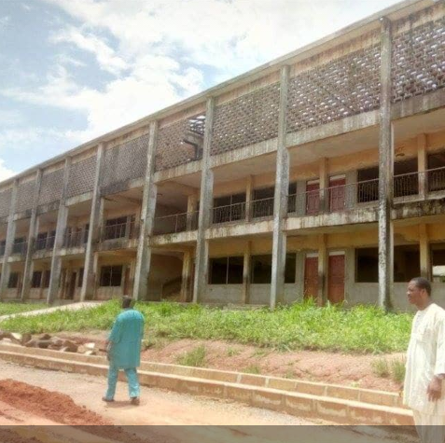
STEPHEN OLUWOLE AWOKOYA
FOUNDATION FOR SCIENCE EDUCATION
Annual Lecture ,Award of Honours
& Post Graduate Scholarships
th
25
OLUWOLE AWOKOYA BLOCK AT MOLUSI COLLEGE
After a powerful rainstorms/wind removed the roof and roofing materials

Slide 8
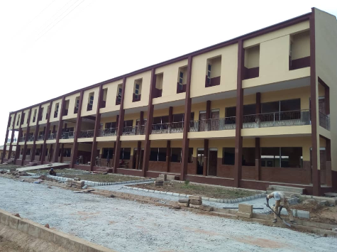
STEPHEN OLUWOLE AWOKOYA
FOUNDATION FOR SCIENCE EDUCATION
Annual Lecture ,Award of Honours
& Post Graduate Scholarships
th
25
OLUWOLE AWOKOYA BLOCK AT MOLUSI COLLEGE
BEFORE AFTER
Awokoya Foundation gave a NGN3.0 Million Assistance

Slide 9
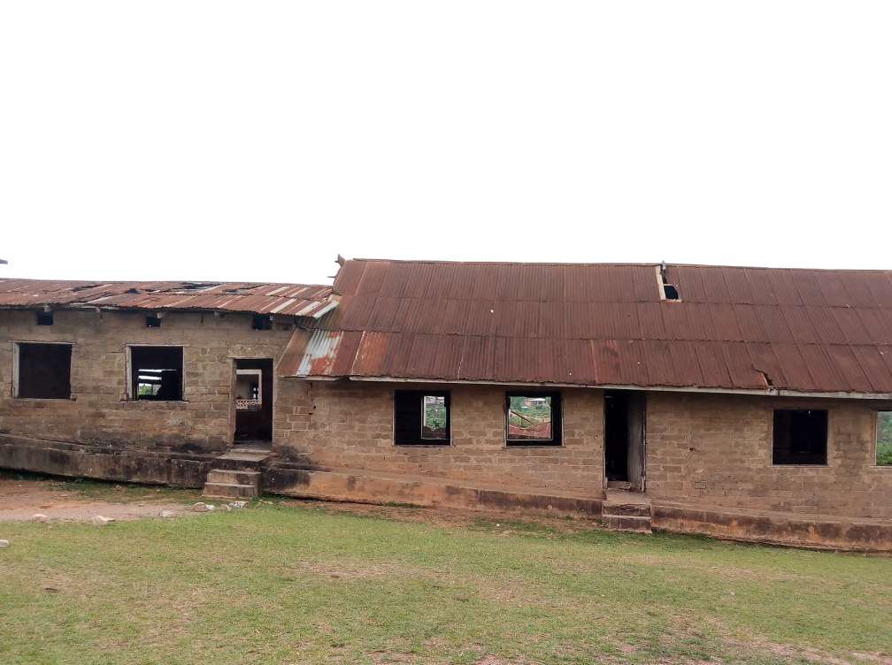
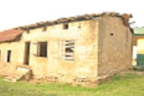
STEPHEN OLUWOLE AWOKOYA
FOUNDATION FOR SCIENCE EDUCATION
Annual Lecture ,Award of Honours
& Post Graduate Scholarships
th
25
WESLEY PRIMARY SCHOOL, AWA-IJEBU, OGUN STATE
UNCOMPLETED CLASSROOMS VIEWS

Slide 10
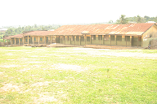
STEPHEN OLUWOLE AWOKOYA
FOUNDATION FOR SCIENCE EDUCATION
Annual Lecture ,Award of Honours
& Post Graduate Scholarships
th
25
WESLEY PRIMARY SCHOOL, AWA-IJEBU, OGUN STATE
CLASSROOM BUILDING WITH ROOFING CHALLENGE

Slide 11
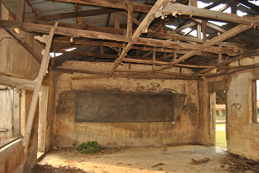
STEPHEN OLUWOLE AWOKOYA
FOUNDATION FOR SCIENCE EDUCATION
Annual Lecture ,Award of Honours
& Post Graduate Scholarships
th
25
WESLEY PRIMARY SCHOOL, AWA-IJEBU, OGUN STATE
INTERNAL VIEW OF A CLASSROOM

Slide 12
STEPHEN OLUWOLE AWOKOYA
FOUNDATION FOR SCIENCE EDUCATION
Annual Lecture ,Award of Honours
& Post Graduate Scholarships
th
25
WESLEY PRIMARY SCHOOL, AWA-IJEBU, OGUN STATE
THE AWOKOYA FOUNDATION ASSISTED WITH THE REFURBISHMENT OF TWO OF THE THREE CLASSROOM BLOCKS WITH A
NGN5.0 MILLION REFURBISHMENT CONTRACT

Slide 13
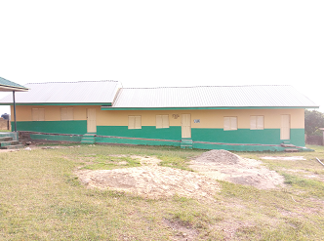
STEPHEN OLUWOLE AWOKOYA
FOUNDATION FOR SCIENCE EDUCATION
Annual Lecture ,Award of Honours
& Post Graduate Scholarships
th
25
WESLEY PRIMARY SCHOOL, AWA-IJEBU, OGUN STATE
BEFORE AFTER
AFTER A NGN5.0 MILLION REFURBISHMENT

Slide 14
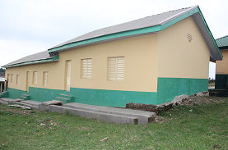
STEPHEN OLUWOLE AWOKOYA
FOUNDATION FOR SCIENCE EDUCATION
Annual Lecture ,Award of Honours
& Post Graduate Scholarships
th
25
WESLEY PRIMARY SCHOOL, AWA-IJEBU, OGUN STATE
BEFORE AFTER
AFTER A NGN5.0 MILLION REFURBISHMENT

Slide 15
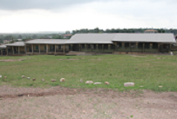
STEPHEN OLUWOLE AWOKOYA
FOUNDATION FOR SCIENCE EDUCATION
Annual Lecture ,Award of Honours
& Post Graduate Scholarships
th
25
WESLEY PRIMARY SCHOOL, AWA-IJEBU, OGUN STATE
BEFORE AFTER
AFTER A NGN5.0 MILLION REFURBISHMENT

Slide 16
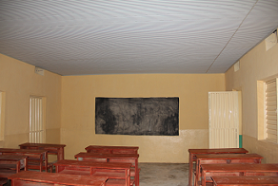
STEPHEN OLUWOLE AWOKOYA
FOUNDATION FOR SCIENCE EDUCATION
Annual Lecture ,Award of Honours
& Post Graduate Scholarships
th
25
WESLEY PRIMARY SCHOOL, AWA-IJEBU, OGUN STATE
BEFORE AFTER
AFTER A NGN5.0 MILLION REFURBISHMENT

Slide 17
STEPHEN OLUWOLE AWOKOYA
FOUNDATION FOR SCIENCE EDUCATION
Annual Lecture ,Award of Honours
& Post Graduate Scholarships
th
25
TOTAL SCHOLARSHIP AWARDED TO DATE: 123

Slide 18
STEPHEN OLUWOLE AWOKOYA
FOUNDATION FOR SCIENCE EDUCATION
COURSE PROGRAM OF AWARD
M.Sc. COURSES
ARCHITECTURE
AGRICULTURE AND INDUSTRIAL TECHNOLOGY
BIOCHEMISTRY
BIOLOGICAL SCIENCES
BIOMEDICAL ENGINEERING
CHEMICAL ENGINEERING
CHEMISTRY
CIVIL ENGINEERING
COMPUTER ENGINEERING
COMPUTER SCIENCE
CONSTUCTION ENGINEERING TECHNOLOGY
CROP/SOIL SCIENCE
ELECTRONICS & ELECTRICAL ENGINEERING
HUMAN NUTRITION
INFORMATION TECHNOLOGY
MATHEMATICS
MECHANICAL ENGINEERING
MECHATRONICS ENGINEERING
MICROBIOLOGY
PHARMACOLOGY
PHYSICS
PHYSIOLOGY
PRODUCTION ENGINEERING
PUBLIC HEALTH
SCIENCE EDUCATION
SPECIAL EDUCATION
Ph.D. COURSES
CARDIOVASCULAR MEDICINE
CHEMICAL PATHOLOGY
CLINICAL PHARMACY
DENTAL SURGERY
MATHS EDUCATION
MECHANICAL ENGINEERING
MEDICINE
PAEDIATRIC MEDICINE
PHARMACEUTICS
PREVENTIVE DENTISTRY
SCIENCE EDUCATION

Slide 19
STEPHEN OLUWOLE AWOKOYA
FOUNDATION FOR SCIENCE EDUCATION
TOP 5 UNIVERSITIES WITH AWARDS TO DATE
UNIVERSITY | NO OF AWARDS TO DATE
UNIVERSITY OF LAGOS | 30
UNIVERSITY OF NIGERIA, NSUKKA | 14
UNIVERSITY OF IBADAN | 12
NNMADI AZIKWE UNIVERSITY | 8
COVENANT UNIVERSITY | 8
TOTAL AWARDS TO DATE 123
TOTAL NO OF UNIVERSITIES 28

Slide 20
S. O. AWOKOYA FOUNDATION FOR SCIENCE EDUCATION
PROCESS OF SCHOLARSHIP AWARD
1. NOMINATION OF CANDIDATES BY THE DEANS OF THE VARIOUS
FACULTIES OR HEADS OF DEPARTMENTS
2. AWARDEES ARE CHOSEN BASED ON EXCELLENCE IN
EDUCATIONAL PERFORMANCE
3. INTERVIEW OF THE SHORTLISTED CANDIDATES BY THE BOARD OF
TRUSTEES.

Slide 21
S. O. AWOKOYA FOUNDATION FOR SCIENCE EDUCATION
2020 APPLICATIONS /NOMINATIONS
No of UNI-52, No of Nominations-169
University | No | University | No
University of Lagos | 10 | Veritas University, Abuja | 3
University Of Nigeria Nsukka | 9 | Bells University | 2
Bayero University, kano | 8 | Bingham University, Nasarawa | 2
Afe Babalola University | 7 | Enugu State University of Science and Technology | 2
Nnamdi Azikwe University, Awka | 7 | Federal University, Lokoja | 2
Kaduna State University | 6 | Kogi State University | 2
Tai Solarin University of Education | 6 | Ladoke Akintola University of Technology, Ogbomosho | 2
Covenant University | 5 | Modibbo Adama University of Technology Yola | 2
Elizade University | 5 | Obafemi Awolowo University | 2
Osun State University | 5 | Abubakar Tafewa Balewa University | 1
Renaissance University, Enugu | 5 | Ahmadu Bello University, Zaria | 1
Salem University, Lokoja | 5 | Alex Ekwueme Federal University Ndufu-Alike, Ebonyi | 1
Yobe State University | 5 | Babcock University | 1
Akwa Ibom State University | 4 | Benson Idahosa University | 1
Federal University of Dutse, Jigawa | 4 | Bowen University, Iwo, Osun | 1
Federal University of Technology, Owerri | 4 | Ekiti State University | 1
Kwara State University | 4 | Federal University of Abeokuta | 1
Olabisi Onabanjo University | 4 | Federal University of Agriculture, Makurdi, Benue State | 1
University of Jos | 4 | Federal University, Dutsin-Ma, Katsina | 1
University of Port Harcourt | 4 | Niger Delta University, Bayelsa | 1
Federal University of Technology, Akure | 3 | Umaru Musa Yar'dua University, Katsina | 1
Federal University of Technology, Minna | 3 | Univeristy of Uyo | 1
Federal University Oye-Ekiti | 3 | University of Abuja | 1
Lagos State University | 3 | University of Benin | 1
Rivers State University, Port Harcourt | 3 | University of Ibadan | 1
University of Uyo | 3 | Usmanu Danfodio University, Sokoto | 1

Slide 22
S. O. AWOKOYA FOUNDATION FOR SCIENCE EDUCATION
DISTRIBUTUION OF CLASS OF DEGREES OF APPLICANTS
FIRST CLASS/DISTINCTION DEGREE GRADUATES 111
2ND CLASS UPPER HONOURS GRADUATES 52
WITHOUT TRANSCRIPT OR RECOMMENDER 6 6
TOTAL 169

Slide 23
S. O. AWOKOYA FOUNDATION FOR SCIENCE EDUCATION
POST-GRADUATE SCHOLARSHIP AWARD
1. COVERS TUITION & BOARD
2. =N=300,000 PER YEAR
3. RENEWABLE EVERY YEAR FOR A MAXIMUM OF 3 YEARS
TENABLE IN ANY NIGERIAN UNIVERSITY
FOR FOREIGN UNIVERSITY ADMISSION. 1st YEAR
SCHOLARSHIP CONVERTED TO TRAVEL GRANT

Slide 24
STEPHEN OLUWOLE AWOKOYA
FOUNDATION FOR SCIENCE EDUCATION
th
Annual Lecture, Award of Honours &
Post Graduate Scholarships
25
2020 POSTGRADUATE SCHOLARSHIP AWARDEES

Slide 25
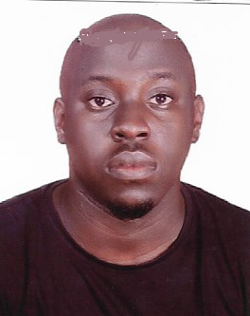
S. O. AWOKOYA FOUNDATION FOR SCIENCE EDUCATION
YEAR 2020 POST-GRADUATE SCHOLARSHIP AWARDEES
9 Distinctions in 9 Subjects in SSC Exams
B.Sc. 1st Class Honours Civil Engineering
(Elizade University )
Best Graduating Student –2018/2019 session
In Civil & Enviromental Engineering
Mr. Akintune Fasuba
AWARD FOR: M.Sc. Civil Engineering

Slide 26
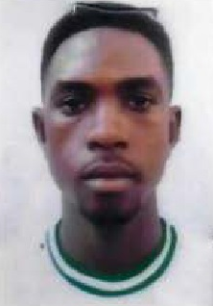
S. O. AWOKOYA FOUNDATION FOR SCIENCE EDUCATION
YEAR 2020 POST-GRADUATE SCHOLARSHIP AWARDEES
8 Distinctions out of 9 subjects in SSCE
with 3 A1s
B.Sc. First Class Honours Architecture
( Covenant University)
4.82 CGPA
Best Graduating student in the 2018/2019 Session
At College of Science & Technology
Mr. Temitope Akinsiku
AWARD FOR: Masters Degree in Architecture

Slide 27
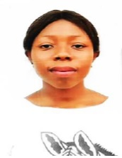
S. O. AWOKOYA FOUNDATION FOR SCIENCE EDUCATION
YEAR 2020 POST-GRADUATE SCHOLARSHIP AWARDEES
9 Distinctions out of 9 subjects in SSCE
with 2 A1s
B.Sc. First Class Honours Crop/Soil Science
( University of Port Harcourt)
Best Graduating student in the Dept. 2018/2019
4.78 CGPA
Miss Cynthia Dike
AWARD FOR: Masters Degree in Crop/Soil Science

Slide 28
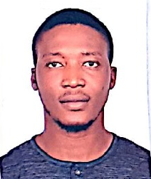
S. O. AWOKOYA FOUNDATION FOR SCIENCE EDUCATION
YEAR 2020 POST-GRADUATE SCHOLARSHIP AWARDEES
8 Distinctions out of 9 subjects in SSCE (with 2 A1)
B.Sc. Electrical/Electronics Engineering
(First Class Honours
4.91 CGPA
( Afe Babalola University )
Mr. Victor Ijeh
AWARD FOR: M.Sc. Electrical/Electronics Engineering

Slide 29
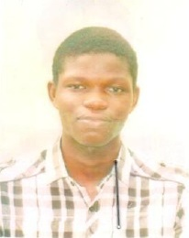
S. O. AWOKOYA FOUNDATION FOR SCIENCE EDUCATION
YEAR 2020 POST-GRADUATE SCHOLARSHIP AWARDEES
8 Distinctions in 8 subjects SSCE (including 3 A1)
B.Sc. Physics (First Class Honours)
4.76 CGPA
( University of Lagos )
Mr. Ayomipo Ojo
AWARD FOR: Postgraduate study in Nanotechnology

Slide 30
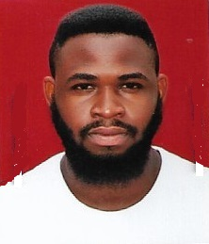
S. O. AWOKOYA FOUNDATION FOR SCIENCE EDUCATION
YEAR 2020 POST-GRADUATE SCHOLARSHIP AWARDEES
8 Distinctions in 9 subjects in WAEC /SSCE with 4 A1
B.Sc. Electrical/Electronics Engineering
(First Class Honours)
(University of Ilorin )
4.87 CGPA
Best graduating student in
Faculty of Science & Technology
( 2018/2019)
Mr Mishael Williams
AWARD FOR: Masters Degree in Telecommunications

Slide 31
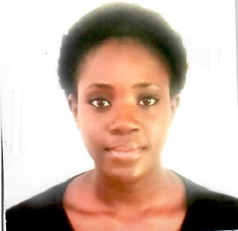
S. O. AWOKOYA FOUNDATION FOR SCIENCE EDUCATION
YEAR 2020 POST-GRADUATE SCHOLARSHIP AWARDEES
9 Distinctions in 9 subjects in WAEC /SSCE with 4 A1
B.Sc. Agriculture & Industrial Technology
(First Class Honours)
(Babcock University )
4.83 CGPA
Miss Opemipo Gbaiye
AWARD FOR: Masters degree in Agriculture & Indudtrial Technology

Slide 32
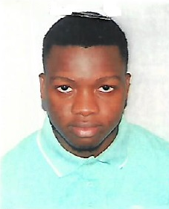
S. O. AWOKOYA FOUNDATION FOR SCIENCE EDUCATION
YEAR 2020 POST-GRADUATE SCHOLARSHIP AWARDEES
9 Distinctions in 9 subjects in WAEC /SSCE with 5 A1
B.Sc. Chemical Engineering
(First Class Honours)
(Babcock University)
4.74 CGPA
Best graduating student in
Dept of Chemical Engineering
( 2018/2019)
Mr Damilola Akinneye
AWARD FOR: Masters Degree in Chemical Engineering

Slide 33
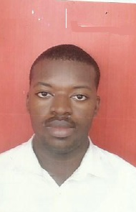
S. O. AWOKOYA FOUNDATION FOR SCIENCE EDUCATION
YEAR 2020 POST-GRADUATE SCHOLARSHIP AWARDEES
9 Distinctions in 9 subjects in WAEC /SSCE with 7 A1
B.Sc. Civil Engineering
(First Class Honours)
(Nnamdi Azikwe University)
4.79 CGPA
Best graduating student in Department
Mr Onyebuchi Agbo-Anike
AWARD FOR: Masters Degree in Civil Engineering

Slide 34
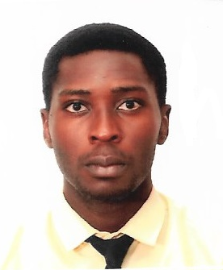
S. O. AWOKOYA FOUNDATION FOR SCIENCE EDUCATION
YEAR 2020 POST-GRADUATE SCHOLARSHIP AWARDEES
9 Distinctions in 9subjects in WAEC /SSCE with 5 A1
B.Sc. Computer Science
First Class Honours
4.93 CGPA
(Afe Babalola University )
Best Graduating Student in Department (2019)
Overall Best Graduating Student in College of Sciences
Mr. Oloruntomi Ojo
AWARD FOR: Masters Program in Computer Science

Slide 35
S. O. AWOKOYA FOUNDATION FOR SCIENCE EDUCATION
25th Annual Lecture &
Award of Post-Graduate Scholarships
2020 AWARDEES
Mr.. Akintunde Fasuba
Mr. Temitope Akinsiku
Miss Cynthia Dike Mr. Victor Ijeh Mr. Ayomipo Ojo
Mr. Onyebuchi Agbo-Anike Mr. Oloruntomi Ojo
Mr. Mishael Williams Miss Opemipo Gbaiye Mr. Damilola Akinneye nneye

Slide 36
STEPHEN OLUWOLE AWOKOYA
FOUNDATION FOR SCIENCE EDUCATION
th
Annual Lecture, Award of Honours
& Post Graduate Scholarships
25
EPIDEMIOLOGY AND TECHNOLOGY, A LOOK AT THE PAST AND PRESENT: JUSTIFICATION FOR MODIFIERS IN MAJOR NON-COMMUNICABLE DISEASES
Special Guest of Honour
Chairman
Chief Chamberlain Oyibo FNMGS, FNAPE
Former GMD NNPC
CEO, Prime Energy Resources
H. E Prince Dapo Abiodun MFR
Executive Governor Ogun State
Prof. Grace O. Otinwa, B.Ed., M.Ed., Ph.D., FNASSAM, FNIS
Professor of Excercise Physiology
University of Lagos
Guest Speaker

Slide 37
STEPHEN OLUWOLE AWOKOYA
FOUNDATION FOR SCIENCE EDUCATION
Annual Lecture , Award of Honours&
Post Graduate Scholarships
th
25
AWARD OF HONOURS

Slide 38
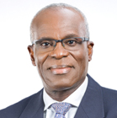
S. O. AWOKOYA FOUNDATION FOR SCIENCE EDUCATION
YEAR 2020 PARTNER IN SCIENCE EDUCATION
HONOURS AWARDEE
Dr. Layi Fatona , FNAPE
B.Sc., M.Sc., Ph.D., DIC, D.Sc.
Founding Managing Director
Niger Delta Exploration & Production PLC

Slide 39
S. O. AWOKOYA FOUNDATION FOR SCIENCE EDUCATION
YEAR 2020 PARTNER IN SCIENCE EDUCATION
HONOURS AWARDEE
Amb. (Prof.) Lawrence B. Ekpebu, OFR
BA. Hons, MA, MPA, Ph.D.
Former Nigerian Ambassador to Ivory Coast

Slide 40
S. O. AWOKOYA FOUNDATION FOR SCIENCE EDUCATION
YEAR 2020 PARTNER IN SCIENCE EDUCATION
HONOURS AWARDEE
Mrs. Catherine Uju Ifejika, OFR
LLB (Hons), ICSAN, FIAC.
Chairperson / CEO Britania- U Group

Slide 41
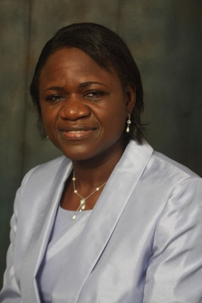
STEPHEN OLUWOLE AWOKOYA
FOUNDATION FOR SCIENCE EDUCATION
th
Annual Lecture , Award of Honours
& Post Graduate Scholarships
25
INTRODUCTION OF GUEST SPEAKER
Prof. Grace O. Otinwa, B.Ed., M.Ed, Ph.D., FNASSM, FNIS
.
Professor of Excercise Physiology
University of Lagos

Slide 42
STEPHEN OLUWOLE AWOKOYA
FOUNDATION FOR SCIENCE EDUCATION
th
Annual Lecture, Award of Honours
& Post Graduate Scholarships
25
EPIDEMIOLOGY AND TECHNOLOGY, A LOOK AT THE PAST AND PRESENT: JUSTIFICATION FOR MODIFIERS IN MAJOR NON-COMMUNICABLE DISEASES
Special Guest of Honour
Chairman
Chief Chamberlain Oyibo FNMGS, FNAPE
Former GMD NNPC
CEO, Prime Energy Resources
H. E Prince Dapo Abiodun MFR
Executive Governor Ogun State
e
Prof. Grace O. Otinwa, B.Ed., M.Ed., Ph.D., FNASSAM, FNIS
Professor of Excercise Physiology
University of Lagos
Guest Speaker

Slide 43
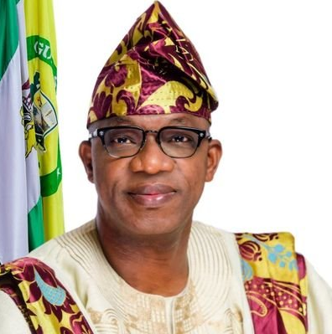
STEPHEN OLUWOLE AWOKOYA
FOUNDATION FOR SCIENCE EDUCATION
th
Annual Lecture, Award of Honours
& Post Graduate Scholarships
25
GUEST OF HONOUR’S REMARKS
H. E. Prince Dapo Abiodun, MFR
Executive Governor Ogun State

Slide 44
STEPHEN OLUWOLE AWOKOYA
FOUNDATION FOR SCIENCE EDUCATION
th
Annual Lecture, Award of Honours &
Post Graduate Scholarships
25
VOTE OF THANKS
BY
Dr. Fola Awokoya, Ph.D. (Engr.)
Member , Board of Trustees

Slide 45
STEPHEN OLUWOLE AWOKOYA
FOUNDATION FOR SCIENCE EDUCATION
th
Annual Lecture, Award of Honours
& Post Graduate Scholarships
25
EPIDEMIOLOGY AND TECHNOLOGY, A LOOK AT THE PAST AND PRESENT: JUSTIFICATION FOR MODIFIERS IN MAJOR NON-COMMUNICABLE DISEASES
Special Guest of Honour
Chairman
Chief Chamberlain Oyibo FNMGS, FNAPE
Former GMD NNPC
CEO, Prime Energy Resources
H. E Prince Dapo Abiodun MFR
Executive Governor Ogun State
Prof. Grace O. Otinwa, B.Ed., M.Ed., Ph.D., FNASSAM, FNIS
Professor of Excercise Physiology
University of Lagos
Guest Speaker

