Slide 1
STEPHEN OLUWOLE AWOKOYA
FOUNDATION FOR SCIENCE EDUCATION
th
Annual Lecture, Award of Honours
& Post Graduate Scholarships
24
TOWARDS SAFER NATAL EXPERIENCES IN NIGERIA: HOW FAR AND WHAT NEXT
Special Guest of Honour
Chairman
Mr. Kayode Sofola, SAN
Principal Partner, Kayode Sofola & Associates
HRH Oba Dr. Adedapo Tejuoso, CON
The Osile of Oke Ona Egbaland
Guest Speaker
Prof. Adetokunbo O. Fabamwo, B.Sc., MBChB, FWACS, FMCOG, FICS
Professor of Obstetrics and Gynecology
Chief Medical Director, LASUTH

Slide 2
STEPHEN OLUWOLE AWOKOYA
FOUNDATION FOR SCIENCE EDUCATION
th
Annual Lecture, Award of Honours
& Post Graduate Scholarships
24
INTRODUCTION OF CHAIRMAN, SPECIAL GUEST OF HONOUR, HONOUREES AND SPECIAL GUESTS

Slide 3
STEPHEN OLUWOLE AWOKOYA
FOUNDATION FOR SCIENCE EDUCATION
th
Annual Lecture, Awath of Honours
&Post Graduate Scholarships
24
WELCOME ADDRESS
BY
SENATOR OLABIYI DUROJAIYE
CHAIRMAN BOARD OF TRUSTEES

Slide 4
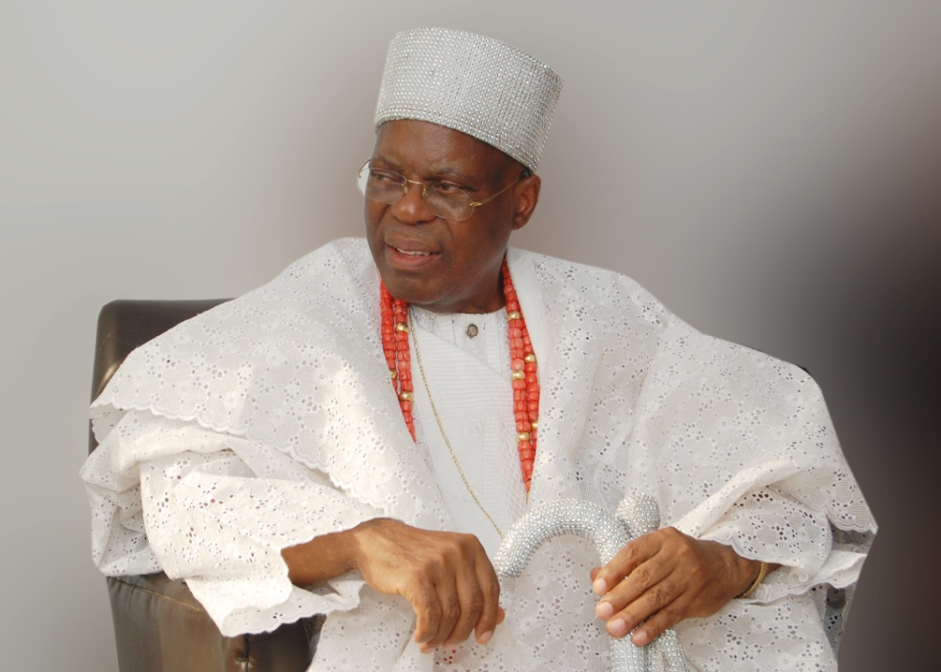
STEPHEN OLUWOLE AWOKOYA
FOUNDATION FOR SCIENCE EDUCATION
Annual Lecture, Award of Honours
&Post Graduate Scholarships
th
24
CHAIRMAN’S OPENING ADDRESS
HRH Oba Dr. Adedapo Tejuoso, CON
The Osile of Oke Ona Egbaland

Slide 5
STEPHEN OLUWOLE AWOKOYA
FOUNDATION FOR SCIENCE EDUCATION
Annual Lecture ,Award of Honours
& Post Graduate Scholarships
th
24
AWARD OF SCHOLARSHIPS
BY
DR. FOLA AWOKOYA Ph.D.(Engr.)
MEMBER , BOARD OF TRUSTEES

Slide 6
STEPHEN OLUWOLE AWOKOYA
FOUNDATION FOR SCIENCE EDUCATION
Annual Lecture ,Award of Honours
& Post Graduate Scholarships
th
24
TOTAL SCHOLARSHIP AWARDED TO DATE: 113

Slide 7
STEPHEN OLUWOLE AWOKOYA
FOUNDATION FOR SCIENCE EDUCATION
COURSE PROGRAM OF AWARD
M.Sc. COURSES
ARCHITECTURE
BIOCHEMISTRY
BIOLOGICAL SCIENCES
BIOMEDICAL ENGINEERING
CHEMICAL ENGINEERING
CHEMISTRY
CIVIL ENGINEERING
COMPUTER ENGINEERING
COMPUTER SCIENCE
CONSTUCTION ENGINEERING TECHNOLOGY
HUMAN NUTRITION
INFORMATION TECHNOLOGY
MATHEMATICS
MECHANICAL ENGINEERING
MECHATRONICS ENGINEERING
MICROBIOLOGY
PHARMACOLOGY
PHYSICS
PHYSIOLOGY
PRODUCTION ENGINEERING
PUBLIC HEALTH
SCIENCE EDUCATION
SPECIAL EDUCATION
Ph.D. COURSES
CARDIOVASCULAR MEDICINE
CHEMICAL PATHOLOGY
CLINICAL PHARMACY
DENTAL SURGERY
MATHS EDUCATION
MECHANICAL ENGINEERING
MEDICINE
PAEDIATRIC MEDICINE
PHARMACEUTICS
PREVENTIVE DENTISTRY
SCIENCE EDUCATION

Slide 8
STEPHEN OLUWOLE AWOKOYA
FOUNDATION FOR SCIENCE EDUCATION
DISTRIBUTION OF AWARDS BY UNIVERSITY-2019
TOTAL 113

Slide 9
S. O. AWOKOYA FOUNDATION FOR SCIENCE EDUCATION
PROCESS OF SCHOLARSHIP AWARD
1. NOMINATION OF CANDIDATES BY THE DEANS OF THE VARIOUS
FACULTIES OR HEADS OF DEPARTMENTS
2. AWARDEES ARE CHOSEN BASED ON EXCELLENCE IN
EDUCATIONAL PERFORMANCE
3. INTERVIEW OF THE SHORTLISTED CANDIDATES BY THE BOARD OF
TRUSTEES.

Slide 10
S. O. AWOKOYA FOUNDATION FOR SCIENCE EDUCATION
APPLICATIONS /NOMINATIONS
No of UNI-42, No of Nominations-150
UNIVERSITY | NOM. | UNIVERSITY | NOM.
UNIVERSITY OF LAGOS | 21 | BABCOCK UNIVERSITY | 2
FEDERAL UNIVERSITY OF TECH., AKURE | 12 | BOWEN UNIVERSITY | 2
SOKOTO STATE UNIVERSITY | 10 | KANO STATE UNIVERSITY OF SCIENCE AND TECH. | 2
BAYERO UNIVERSITY | 7 | NNAMDI AZIKIWE UNIVERSITY | 2
UMARU MUSA YAR'ADUA UNIVERSITY, KATSINA | 7 | OSUN STATE UNIVERSITY | 2
KADUNA STATE UNIVERSITY | 6 | UNIVERSITY OF BENIN | 2
UNIVERSITY OF NIGERIA | 6 | UNIVERSITY OF PORT HARCOURT | 2
ACHIEVERS UNIVERSITY | 5 | LAGOS STATE UNIVERSITY | 2
LADOKE AKINTOLA UNIVERSITY OF TECH. | 5 | ABIA STATE UNIVERSITY | 1
OBAFEMI AWOLOWO UNIVERSITY | 5 | AFE-BABALOLA UNIVERSITY | 1
TAI SOLARIN UNIVERSITY OF EDUCATION | 5 | AKWA-IBOM STATE UNIVERSITY | 1
UNIVERSITY OF IBADAN | 5 | BAZE UNIVERSITY | 1
ELIZADE UNIVERSITY | 4 | DELTA STATE UNIVERSITY | 1
FEDERAL UNIVERSITY OF AGRICULTURE, ABEOKUTA | 4 | EKITI STATE UNIVERSITY | 1
FEDERAL UNIVERSITY OF TECHNOLOGY, OWERRI | 4 | JOSEPH AYO BABALOLA UNIVERSITY | 1
AJAYI CROWTHER UNIVERSITY | 3 | LEAD CITY UNIVERSITY | 1
UNIVERSITY OF ILORIN | 3 | MICHEAL OKPARA UNIVERSITY OF AGRICULTURE | 1
USMANU DANFODIYO UNIVERSITY | 3 | REDEEMERS UNIVERSITY | 1
ABUBAKAR TAFAWA BALEWA UNIVERSITY | 2 | UNIVERSITY OF ABUJA | 1
AHMADU BELLO UNIVERSITY | 2 | UNIVERSITY OF CALABAR | 1
ALEX-EKWUEME FEDERAL UNIVERSITY | 2 | UNIVERSITY OF JOS | 1

Slide 11
S. O. AWOKOYA FOUNDATION FOR SCIENCE EDUCATION
DISTRIBUTUION OF CLASS OF DEGREES OF APPLICANTS
FIRST CLASS/DISTINCTION DEGREE GRADUATES 111
2ND CLASS UPPER HONOURS GRADUATES 33
NOT CLASSIFIED 6
TOTAL 150

Slide 12
S. O. AWOKOYA FOUNDATION FOR SCIENCE EDUCATION
POST-GRADUATE SCHOLARSHIP AWARD
1. COVERS TUITION & BOARD
2. =N=300,000 PER YEAR
3. RENEWABLE EVERY YEAR FOR A MAXIMUM OF 3 YEARS
TENABLE IN ANY NIGERIAN UNIVERSITY
FOR FOREIGN UNIVERSITY ADMISSION. 1st YEAR
SCHOLARSHIP CONVERTED TO TRAVEL GRANT

Slide 13
STEPHEN OLUWOLE AWOKOYA
FOUNDATION FOR SCIENCE EDUCATION
th
Annual Lecture, Award of Honours &
Post Graduate Scholarships
24
2019 POSTGRADUATE SCHOLARSHIP AWARDEES

Slide 14
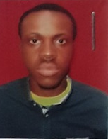
S. O. AWOKOYA FOUNDATION FOR SCIENCE EDUCATION
YEAR 2019 POST-GRADUATE SCHOLARSHIP AWARDEES
9 Distinctions in 9 Subjects in SSC Exams
B.Sc. 1st Class Honours Mechatronics Engineering
(Afe Babalola University )
Best Graduating Student –2017/2018 session
Mr. Joshua Adewolu
AWARD FOR: M.Sc. Mechatronics Engineering

Slide 15
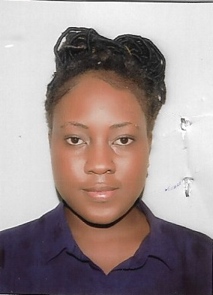
S. O. AWOKOYA FOUNDATION FOR SCIENCE EDUCATION
YEAR 2019 POST-GRADUATE SCHOLARSHIP AWARDEES
8 Distinctions out of 9 subjects in SSCE
with 2 A1s
B.Sc. First Class Honours Computer Science
( Redeemer’s University, Ede,Osun State) 4.78 CGPA
Highest Highest CGPA to date at Redeemer’s University
Miss. Oseremen Joy Idialu
AWARD FOR: Masters Degree in Computer Science

Slide 16
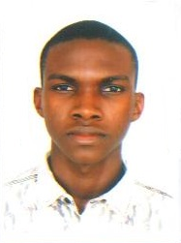
S. O. AWOKOYA FOUNDATION FOR SCIENCE EDUCATION
YEAR 2019 POST-GRADUATE SCHOLARSHIP AWARDEES
8 Distinctions out of 9 subjects in SSCE
with 5 A1s
B.Sc. First Class Honours Architecture
( Federal University of Technology, Akure)
Best Graduating student in 2017/2018
4.57 CGPA
Mr. Laughter Fiyinfoluwa Olagunju
AWARD FOR: Masters Degree in Architecture

Slide 17
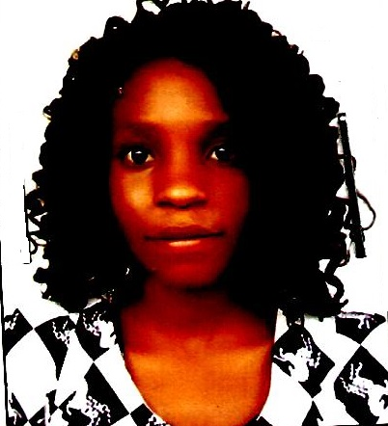
S. O. AWOKOYA FOUNDATION FOR SCIENCE EDUCATION
YEAR 2019 POST-GRADUATE SCHOLARSHIP AWARDEES
9 Distinctions out of 9 subjects in SSCE (with 4 A1)
B.Sc. Microbiology (First Class Honours
6.7 CGPA
( University of Ibadan)
Best Graduating Student in Microbiology
Miss Adedoyin Adeyemi
AWARD FOR: M.Sc. Microbiology

Slide 18
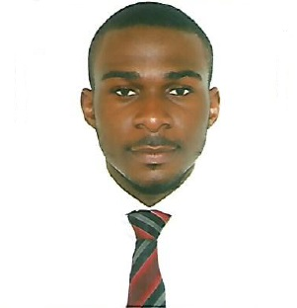
S. O. AWOKOYA FOUNDATION FOR SCIENCE EDUCATION
YEAR 2019 POST-GRADUATE SCHOLARSHIP AWARDEES
8 Distinctions in 9 subjects SSCE (including 4 A1)
B.Sc. Pharmacy
4.87 CGPA
( University of Lagos )
Mr. Obinwanne Enewally
AWARD FOR: M.Sc. in Pharmacy

Slide 19
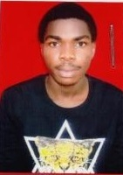
S. O. AWOKOYA FOUNDATION FOR SCIENCE EDUCATION
YEAR 2019 POST-GRADUATE SCHOLARSHIP AWARDEES
9 Distinctions in 9 subjects in WAEC /SSCE with 7 A1
B.Sc. Electronics Engineering (First Class Honours)
(University of Nigeria, Nsukka )
4.83 CGPA
Best graduating student in Department 2018
Mr Chukwuemeka Nwagu
AWARD FOR: Masters Degree in Electronics Engineering

Slide 20
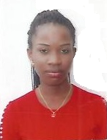
S. O. AWOKOYA FOUNDATION FOR SCIENCE EDUCATION
YEAR 2019 POST-GRADUATE SCHOLARSHIP AWARDEES
9 Distinctions in 9 subjects in WAEC /SSCE with 8 A1
B.Sc. Pure & Industrial Chemistry
(First Class Honours)
(University of Nigeria, Nsukka )
4.84 CGPA
Miss Patience Abugu
AWARD FOR: Masters Degree in Pure & Industrial Chemistry

Slide 21
STEPHEN OLUWOLE AWOKOYA
FOUNDATION FOR SCIENCE EDUCATION
Annual Lecture ,Award of Honours
& Post Graduate Scholarships
th
24
AWARD OF SCHOLARSHIPS
BY
DR. FOLA AWOKOYA Ph.D.(Engr.)
MEMBER , BOARD OF TRUSTEES

Slide 22
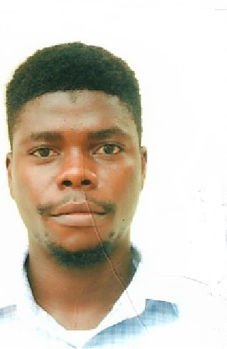
S. O. AWOKOYA FOUNDATION FOR SCIENCE EDUCATION
YEAR 2019 POST-GRADUATE SCHOLARSHIP AWARDEES
9 Distinctions in 9subjects in WAEC /SSCE with 7 A1
B.Sc. Petroleum & Gas Engineering
First Class Honours
4.92/5.0 CGPA
(University of Lagos)
Best Graduating Student in Department (2018)
Mr. Adeola Adeyemo
AWARD FOR: Post-Graduate Program in Petroleum & Gas Engineering

Slide 23
S. O. AWOKOYA FOUNDATION FOR SCIENCE EDUCATION
24th Annual Lecture &
Award of Post-Graduate Scholarships
2019 AWARDEES
Mr.. Adeola Adeyemo
Miss Patience Abugu
Mr. Chukwuemeka Nwagu Mr. Obinwanne Enewally
Miss Osemeren Idialu Mr. Joshua Adewole
Miss Adedoyin Adeyemi Mr. Laughter Olagunju

Slide 24
STEPHEN OLUWOLE AWOKOYA
FOUNDATION FOR SCIENCE EDUCATION
th
Annual Lecture, Award of Honours
& Post Graduate Scholarships
24
TOWARDS SAFER NATAL EXPERIENCES IN NIGERIA: HOW FAR AND WHAT NEXT
Special Guest of Honour
Chairman
Mr. Kayode Sofola, SAN
Principal Partner, Kayode Sofola & Associates
HRH Oba Dr. Adedapo Tejuoso, CON
The Osile of Oke Ona Egbaland
Guest Speaker
Prof. Adetokunbo O. Fabamwo, B.Sc., MBChB, FWACS, FMCOG, FICS
Professor of Obstetrics and Gynecology
Chief Medical Director, LASUTH

Slide 25
STEPHEN OLUWOLE AWOKOYA
FOUNDATION FOR SCIENCE EDUCATION
Annual Lecture , Award of Honours&
Post Graduate Scholarships
th
24
AWARD OF HONOURS

Slide 26
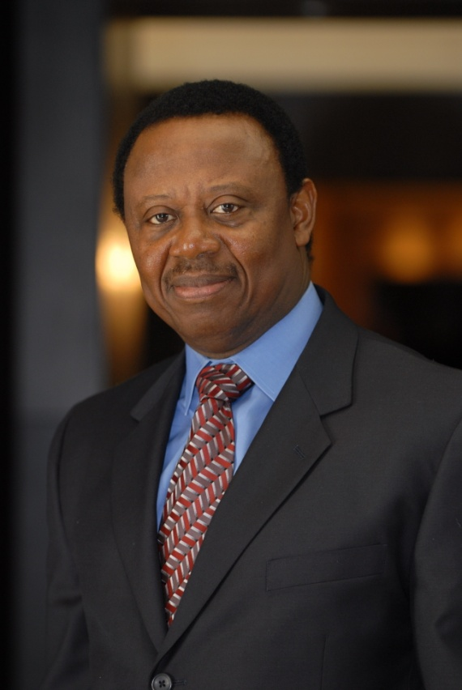
S. O. AWOKOYA FOUNDATION FOR SCIENCE EDUCATION
YEAR 2019 PARTNER IN SCIENCE EDUCATION
HONOURS AWARDEE
Chief (Dr.) Tunde Afolabi, MFR, FNAPE, FNM&GS
Chairman , Amni International Dev. Company
Chancellor, Oyo Technical University, Ibadan

Slide 27
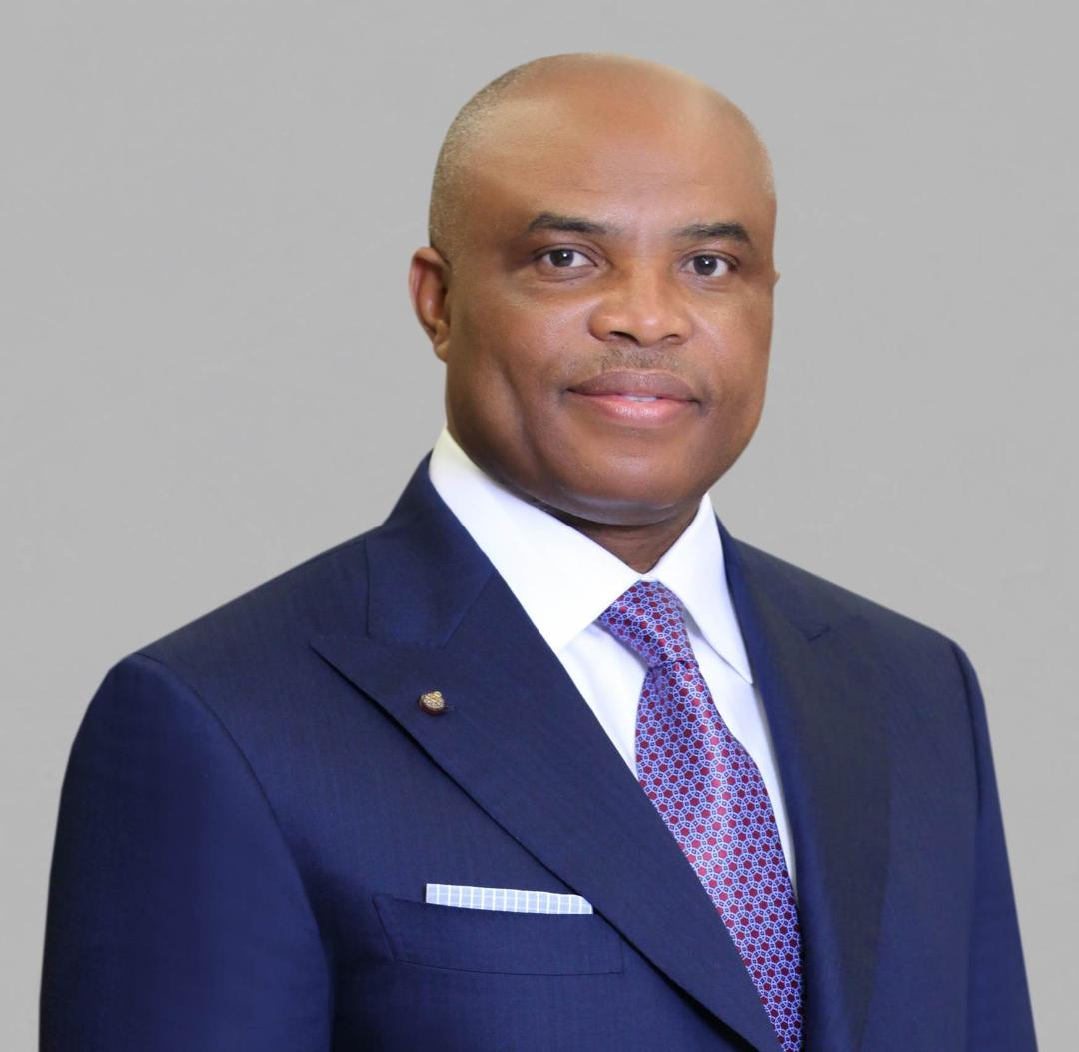
S. O. AWOKOYA FOUNDATION FOR SCIENCE EDUCATION
YEAR 2019 PARTNER IN SCIENCE EDUCATION
HONOURS AWARDEE
Dr. A. B. C. Orjiako, FWACS
Chairman , Seplat Petroleum Development Company Plc.
Chairman, Niemeth Pharmaceticals Plc.

Slide 28
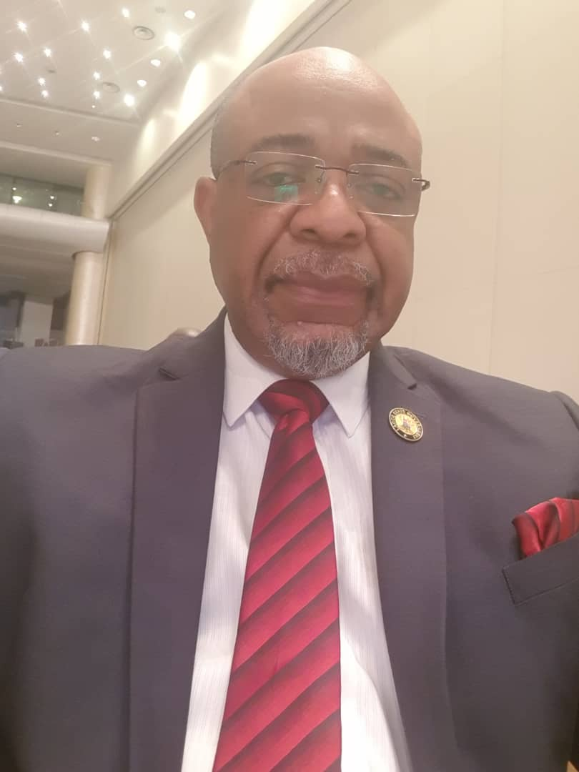
STEPHEN OLUWOLE AWOKOYA
FOUNDATION FOR SCIENCE EDUCATION
th
Annual Lecture , Award of Honours
& Post Graduate Scholarships
24
INTRODUCTION OF GUEST SPEAKER
Prof. Adetokunbo O. Fabamwo, B.Sc., MBChB, FWACS, FMCOG, FICS
.
Professor of Obstetrics and Gynecology
Chief Medical Director, LASUTH

Slide 29
STEPHEN OLUWOLE AWOKOYA
FOUNDATION FOR SCIENCE EDUCATION
th
Annual Lecture, Award of Honours
& Post Graduate Scholarships
24
TOWARDS SAFER NATAL EXPERIENCES IN NIGERIA: HOW FAR AND WHAT NEXT
Special Guest of Honour
Chairman
Mr. Kayode Sofola, SAN
Principal Partner, Kayode Sofola & Associates
HRH Oba Dr. Adedapo Tejuoso, CON
The Osile of Oke Ona Egbaland
Guest Speaker
Prof. Adetokunbo O. Fabamwo, B.Sc., MBChB, FWACS, FMCOG, FICS
Professor of Obstetrics and Gynecology
Chief Medical Director, LASUTH

Slide 30
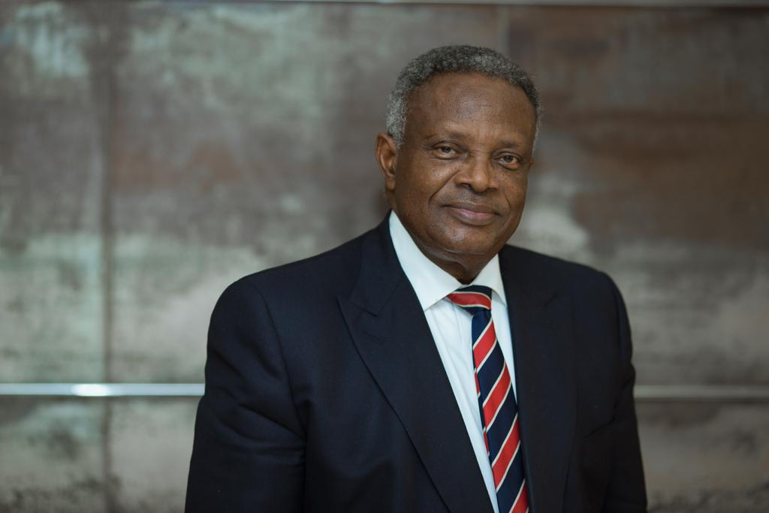
STEPHEN OLUWOLE AWOKOYA
FOUNDATION FOR SCIENCE EDUCATION
th
Annual Lecture, Award of Honours
& Post Graduate Scholarships
24
GUEST OF HONOUR’S REMARKS
Mr. Kayode Sofola, SAN
Principal Partner, Kayode Sofola & Associates

Slide 31
STEPHEN OLUWOLE AWOKOYA
FOUNDATION FOR SCIENCE EDUCATION
th
Annual Lecture, Award of Honours &
Post Graduate Scholarships
24
VOTE OF THANKS
BY
Dr. Sonny Kuku
Member , Board of Trustees

Slide 32
STEPHEN OLUWOLE AWOKOYA
FOUNDATION FOR SCIENCE EDUCATION
th
Annual Lecture, Award of Honours
& Post Graduate Scholarships
24
TOWARDS SAFER NATAL EXPERIENCES IN NIGERIA: HOW FAR AND WHAT NEXT
Special Guest of Honour
Chairman
Mr. Kayode Sofola, SAN
Principal Partner, Kayode Sofola & Associates
HRH Oba Dr. Adedapo Tejuoso, CON
The Osile of Oke Ona Egbaland
Guest Speaker
Prof. Adetokunbo O. Fabamwo, B.Sc., MBChB, FWACS, FMCOG, FICS
Professor of Obstetrics and Gynecology
Chief Medical Director, LASUTH

